Slide 1
Power Apps Component Framework (PCF)

Slide 2



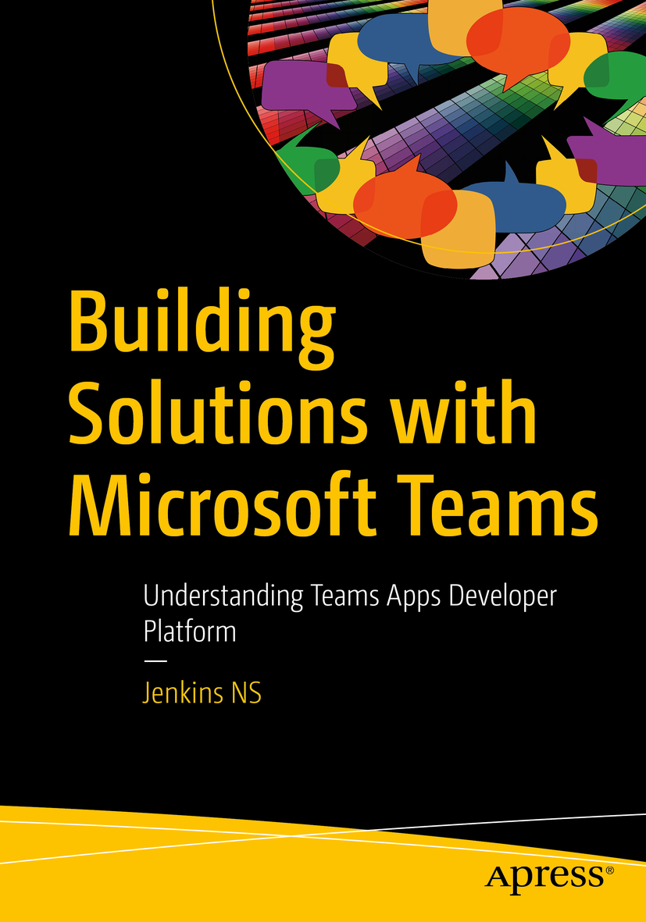








Jenkins NS
Modern Workplace Solution Architect | Consultant
Chennai, India
MVP | MCT | International Speaker | Author | Trainer
Microsoft Teams, Power Platform and SPFx Specialist
M365 Bangalore Organizer
aMS Ambassador
SharePoint-er Since 2005!
@jenkinsns
https://www.linkedin.com/in/jenkinsns/
https://www.youtube.com/user/jenkinsnss
Notes:
Hyperlinks in PowerPoint are active for the attendees if you use PowerPoint Live sharing in Teams.

Slide 3
Introduction to Power Platform

Slide 4

Notes:
It starts with how they get the most out of their business data
Data is everywhere – generated at every step of our lives
90% of world’s data generated in last 3 years alone
Everything we do, everything our customers do, everything competitors do generates some kind of data
T: In the old world, that data lived in siloes

Slide 5

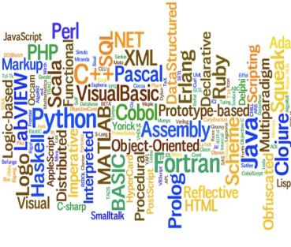


The evolution of how people buy applications
Custom Software
Packaged Software
Low-code Development
What development language do you use?
How feature rich is your software?
How agile and extensible is your platform?
ERP
CRM
HRM
ERP
CRM
HRM
Middle
-ware
MRP
Middle
-ware
PRM
MRP
PRM
MRP
OPS
LOG.
…
OPS
PRM
…

Slide 6
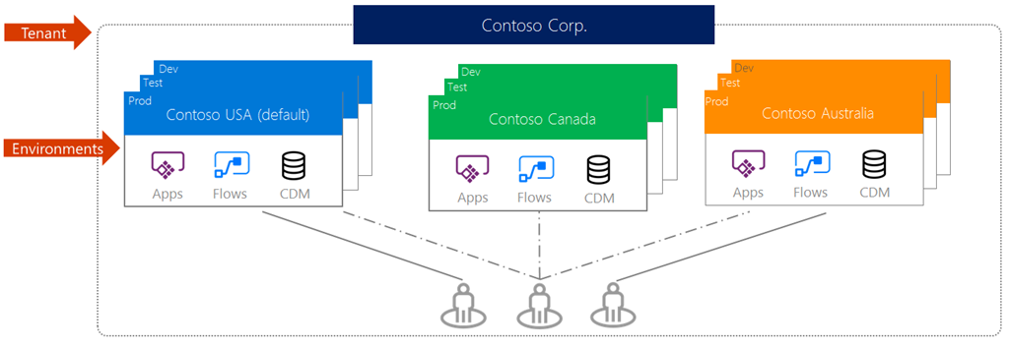
Environments
Support for environments to enable enterprise scale out and improved manageability

Slide 7
Canvas App vs Model-Driven Apps

Slide 8




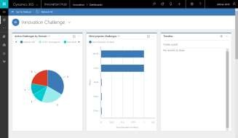
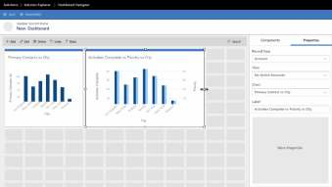


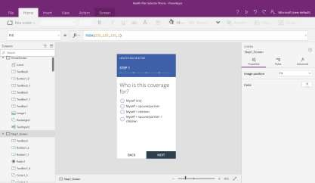
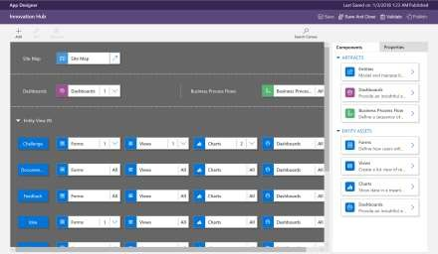

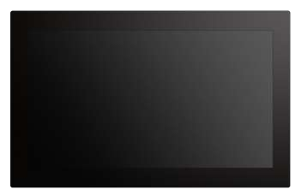
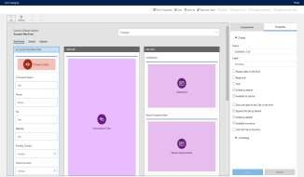
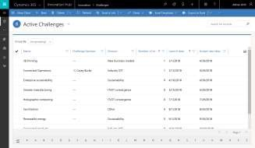
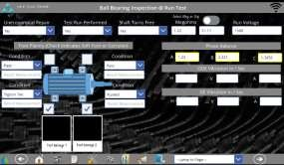
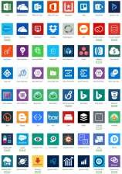
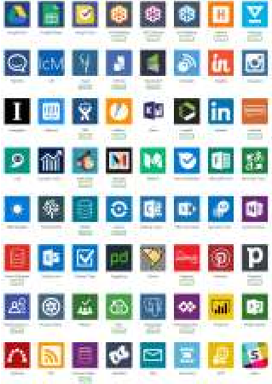

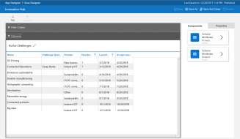
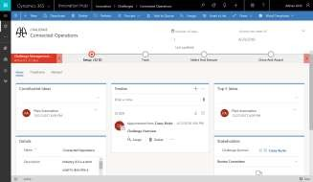
Canvas apps
Start with user experience WYSIWYG (what you see is what you get) designer
Role-based apps
Mash up data from 560+ sources
Model-driven apps
Built on the Common Data Service for Apps Start with a data model, relationships, and business processes
Build End-to-End business applications

Slide 9

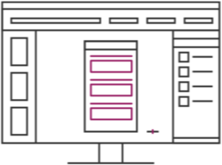
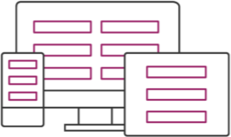
Canvas Apps help business-power-users to create and use custom business apps across platforms
using Excel and PowerPoint skills
Connect to data & systems you’re already using easily
Create apps, forms, and workflows without writing code
Use apps on any device – both web and mobile

Slide 10

Introduction to Power Apps Component Framework (PCF)
The Power Apps Component Framework (PCF) is a powerful tool for developers to create highly customizable and interactive components that extend the capabilities of Power Apps beyond standard, out-of-the-box controls. It offers a way to integrate advanced functionalities and interactions using modern web development tools.

Slide 11
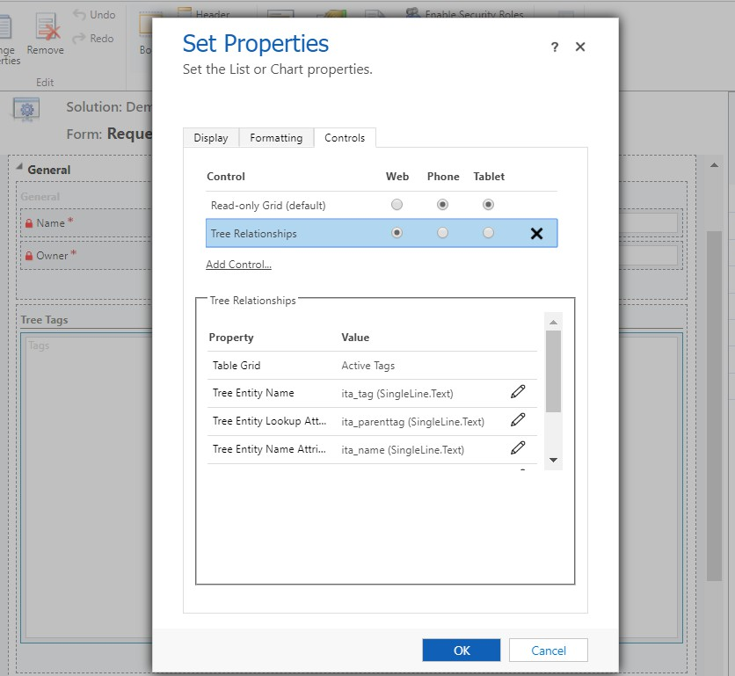
Why Use PCF?
Standard Power Apps controls are great for basic scenarios, but they can sometimes lack the flexibility needed for complex business requirements. PCF addresses these limitations by enabling developers to:
Build controls with advanced UI/UX interactions.
Integrate external data sources and APIs seamlessly.
Provide a consistent, reusable experience across multiple apps.
Reusable & configurable
(properties/values/configuration)
Solution-Aware
No iframes anymore, no additional
form scripts to control the iframe, much less related “plumbing”
Can be developed by developers and easily re-used by makers

Slide 12
A few things to consider
If you are an organization:
You can start building reusable component to utilize them across different solutions. You will need somebody with a little more advanced dev skills to do that
If you are an ISV, there are apparent
opportunities there
It’s easy with PCF to utilize third-party components (but think about their supportability, too)
If you are a developer:
It’s a great new framework for developers
There are no iframes
Typescript is enforced
It’s easy to build redistributable components
If you are a maker:
You can easily reuse PCF components developed by professional developers
PCF components are configurable
May need to pay attention to the future compatibility/maintenance

Slide 13
PCF vs Embedded Canvas Apps
PCF:
HTML & Scripting, Web API, configurable property bindings, professional developers expertise
Embedded Canvas Apps:a
Various connectors, canvas app look and feel, citizen development expertise

Slide 14
Licensing
Power Apps component framework licensing requirements are inline with existing connectors and components and are based on the type of data and connections used in your app. More information: Power Apps pricing. To align with the licensing requirements, we will be classifying code components into two types
Code components that connect to external services or data directly via the user's browser client and not through connectors are considered as premium. When these components are used in an app, the app becomes premium, and end-users are required to have Power Apps licenses.
Code components that don't connect to external services or data. When these components are used in an app that uses standard features, the app remains standard, and end- users are required to be licensed at minimum for Office 365.
Code components can be declared as premium components by adding a <external-service-usage> node to the component's manifest file with all the external service domains this component is connecting to.
<external-service-usage enabled="true">
<domain>www.microsoft.com</domain>
</external-service-usage>

Slide 15
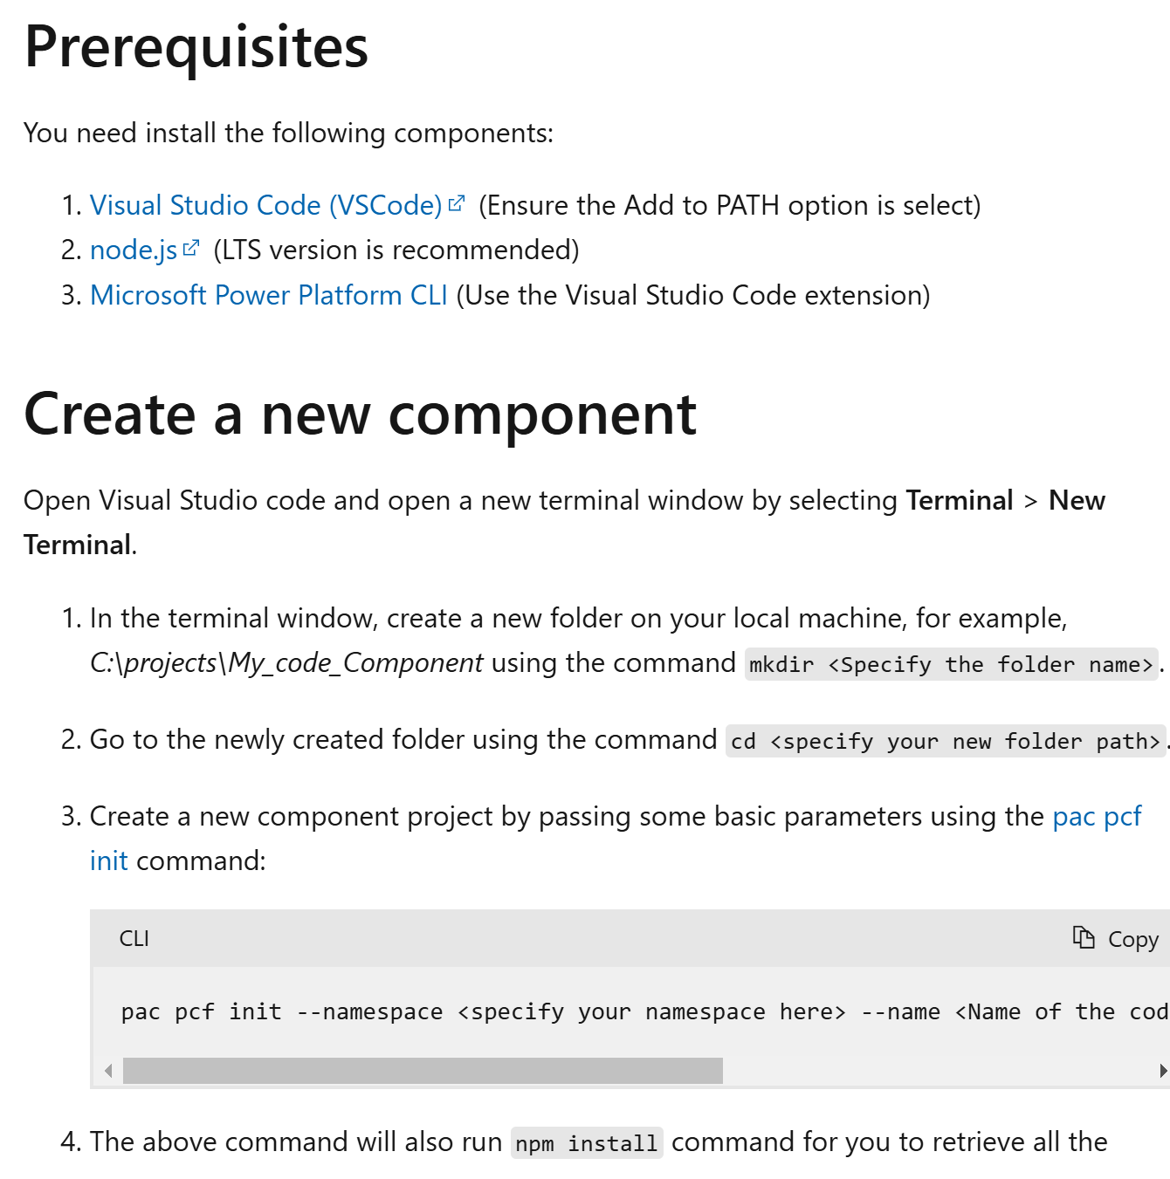
Ready to start building your own component?
Go here: https://learn.microsoft.com/en-us/power-apps/developer/component-framework/create-custom-controls-using-pcf

Slide 16



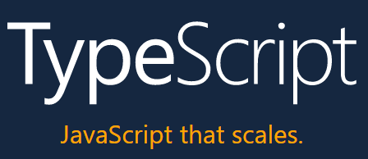

What’s involved
Node.js® is a JavaScript runtime
npm makes it easy for JavaScript developers to share and reuse code, and makes it easy to update the code that you’re sharing, so you can build amazing things.
JavaScript
JQuery
Solutions
React
Angular
PowerShell
It is a strict syntactical superset of JavaScript that adds optional static typing to the language
Visual Studio Code

Slide 17
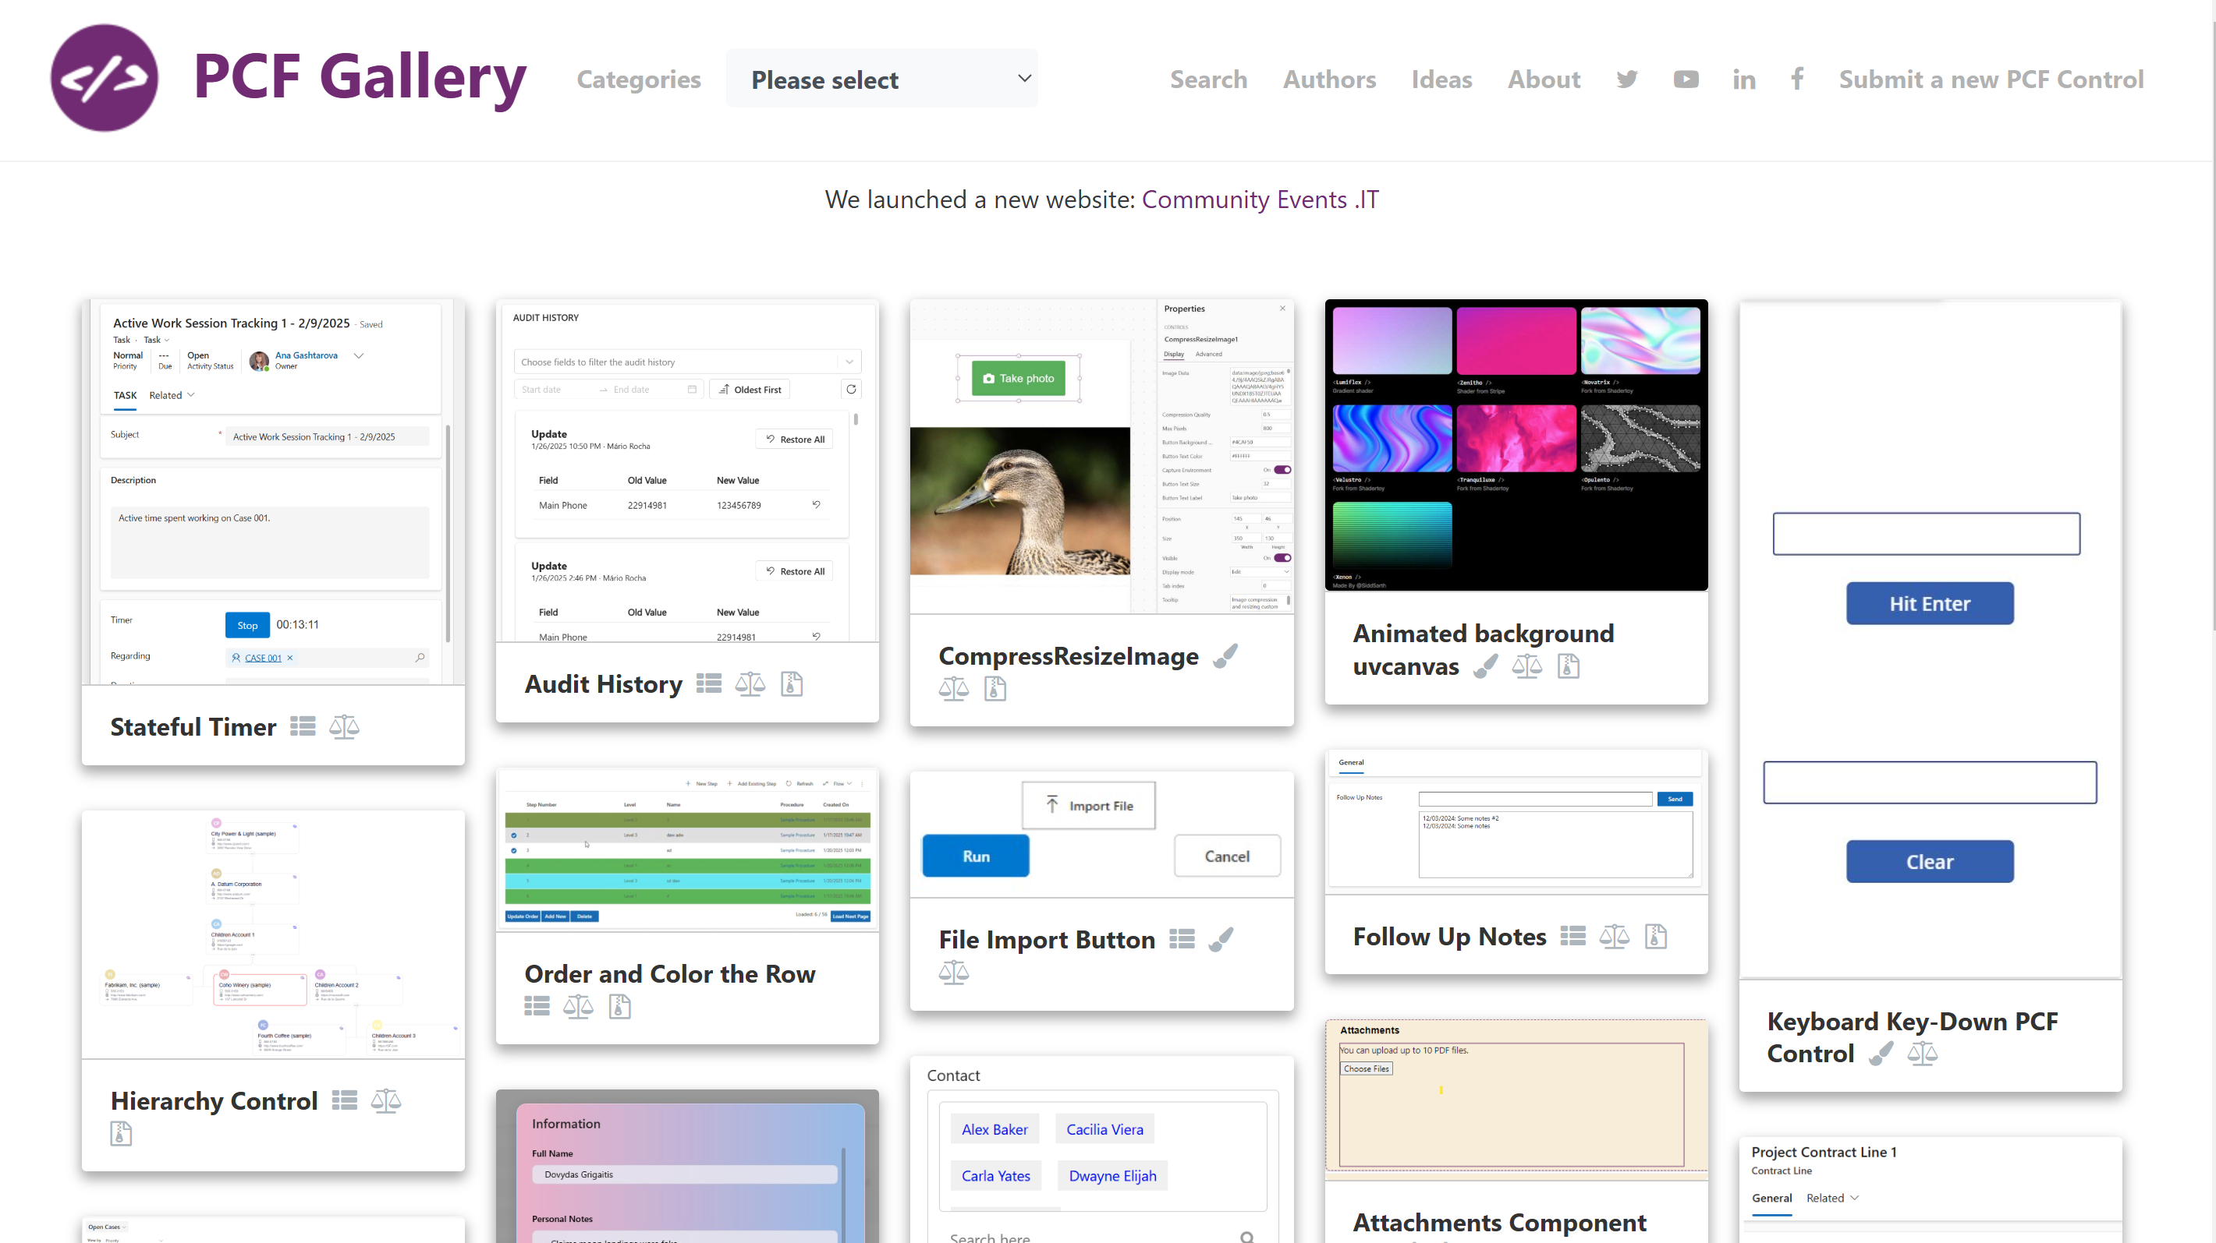
PCF Gallery
Mostly free components with the usual pros and cons:
you can find awesome open-source components there, but the level of support behind them will vary depending on the willingness and availability of their creators.
https://pcf.gallery/
Developed and maintained by Guido Preite, MVP

Slide 18

Who can build PCF components?
As long as you know the basics of html & javascript, you should be able to
create PCF components
because
Essentially, it’s front-end development
however
Just as it used to be with the the web-resources, PCF development can vary in complexity from being relatively simple to being extremely advanced

Slide 19
Tools You Will Need
Visual Studio Code with Node.js installed
Power Apps CLI (command line interface). Be sure to grab the latest with pac install latest. You can use the Windows version or the VS Code Extension.
msbuild (installed through Visual Studio)

Slide 20
Step 4: Create a component
Create a folder for your component
Initialize the component
pac.exe pcf init --namespace ItAintBoring.PCFControls --name DemoRegexValidation --
template field
npm install
Step 5: Build and test the component
npm run build
npm start (or you can use start npm start to open a new window)

Slide 21
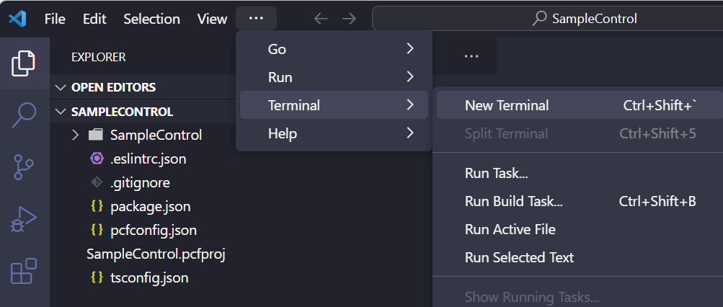
Setup
First, we will create a folder to hold our control. I created a folder located at C:\PCF\SampleControl
Explore the pac pcf commands available in the cli, which we can do with: > pac pcf help
create a control with the command: pac pcf init --name SampleControl --namespace carl --template field
Example : pac pcf init -n SampleControl -ns carl -t field
npm install
npm start
npm start watch

